Slide 1
G-CEL 2020
A Deeper Look at the 1% Cap for
the Alternate Assessment .
August Ogletree, Ph.D. March 9, 2020
Crystal R. Callaway, M.ED.

Slide 2
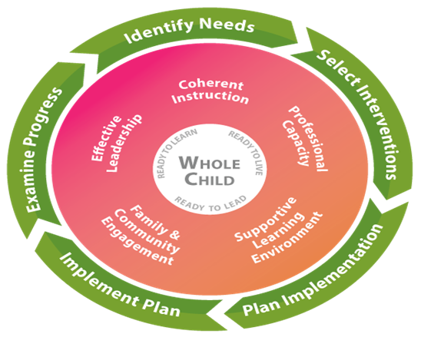
Georgia’s Systems of Continuous Improvement
http://www.gadoe.org/Curriculum-Instruction-and-Assessment/Special-Education-Services/Pages/default.aspx
Notes:
The Georgia’s Systems of Continuous Improvement. Is a Formula for Success. The Georgia Department of Education utilizes the Systems of Continuous Improvement cycle for student improvement.
It addresses five key areas to support the student.
Coherent Instruction, this system articulates and guides the what and how of instruction
Professional Capacity, this system develops a quality staff to reduce the variance of quality in instruction throughout the school
Supporting Learning Environment, this system ensures that the student’s school participation and willingness to expand major effort on classroom learning
Family and Community Engagement, this system develops quality links between local school professionals and the parents and community the school is intended to serve
And finally Effective Leadership, this system sets the direction for the school, ensures that the school’s staff is capable of meeting that direction, and makes sure the organization functions according to its mission.
The Key is that we, as educators, are addressing the needs of the whole child. For more information on the Georgia’s Systems of Continuous Improvement, you may visit our website.

Slide 3
Purpose
Review the alternate assessment 1% Cap and ESSA
Understand the 1% Cap calculation
Know where to review the Publicly Released Justifications
Understand how Disproportionality Data are calculated
Know how to interpret Disproportionality Data
View and Analyze Georgia Alternate Assessment 2.0 (GAA 2.0) Data
Understand how students are eligible for the GAA 2.0
Discuss questions for IEP teams considering if a student is eligible

Slide 4
1% Cap on AA-AAAS Participation

Slide 5
1% Cap as outlined in ESSA
Federal Government places a 1% cap on states for alternate assessment participation
Federal Government prohibits a local cap on alternate assessment participation
States must request a waiver to the 1% cap if they exceed the waiver
States must calculate the percentage of students participating in alternate assessments by LEA and then collect and publicly report justifications for those LEAs that exceed a 1% cap

Slide 6
1% Cap Waiver and Georgia
The Federal Government is looking for a steady decrease in the percentage of students participating in the alternate assessment
Evident the percentage
Evident in work included in the State Plan
Georgia has applied for and received a Waiver to the 1% Cap for the past 4 years
Waivers are posted on the Accountability Webpage

Slide 7
1% Cap Calculation for Georgia
GAA 1% calculation for all students
$$100∗(\frac{GAA Assessment Records}{GAA Assessment Records+EOG \& EOC Assessment Records}$$
Round to 1 Decimal Place
Same calculation is used for both State and LEA rates
School Year | 2016 | 2017 | 2018 | 2019
English language arts | 1.2 | 1.3 | 1.3 | 1.3
Mathematics | 1.2 | 1.3 | 1.3 | 1.2
Science | 1.2 | 1.4 | 1.2 | 1.3
Social Studies | 1.2 | 1.3 | 1.3 | 1.4

Slide 8
1% Cap Calculation Detailed
ELA
Grades 3-8 EOG Test Scores
American Lit EOC Test Scores
ELA GAA Test Scores
Mathematics
Grades 3-8 EOG Test Scores
Geometry EOC Test Scores
Mathematics GAA Test Scores
Science
Grades 5 & 8 EOG Test Scores
Biology EOC Test Scores
Science GAA Test Scores
Social Studies
Grades 5 & 8 EOG Test Scores
Economics EOC Test Scores
Social Studies GAA Test Scores

Slide 9
Georgia LEA Justifications
70% of Georgia’s LEAs’ exceed the GAA 1% Cap
All LEAs that exceed the cap have submitted through the GAA 1% Application in the portal justifications for public release
Not asking for permission to exceed the 1% Cap
Not asking for approval for the reason the 1% Cap was exceeded
Justifications explain to the public why the 1% Cap was exceeded
Districts that violated the guidelines have been contacted for required submission of revised comments
Notes:
Updated this slide 01.24.2020

Slide 10
Public Posting of Justifications
2019 Justifications will be publicly posted on the GaDOE Accountability Website
Special Education will use information from both the 2018-2019 and 2019-2020 to support identification of districts for Tiered Support

Slide 11
Disproportionality

Slide 12
Disproportionality
USED requires that waivers include assurance that disproportionality in GAA Participation among student subgroups is addressed
Disproportionality - the over-representation of minority students identified with a learning disability or other type of disability under the IDEA
Disproportionality is expressed as a relative risk ratio

Slide 13
Disproportionality Calculation

Slide 14
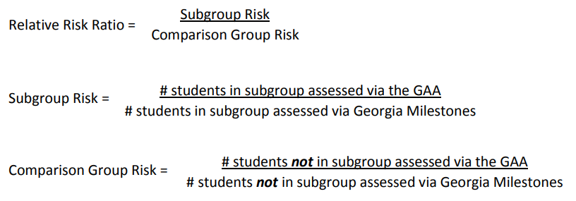
What do I need to focus on?
Is the likelihood of a student in a particular subgroup to be identified for GAA 2.0 participation significantly higher than other subgroups in my district?
Subgroups with higher rates indicate an increased likelihood for students in that subgroup to be identified for GAA 2.0 participation than students not in the subgroup.
The subgroup assessed via Milestones count must be greater than or equal to 15 for a relative risk ratio to be reported.
Use care when interpreting disproportionality as the count of students in the subgroup greatly impacts the disproportionality relative risk ratio
Notes:
Updated Slide

Slide 15
Tiered Support

Slide 16
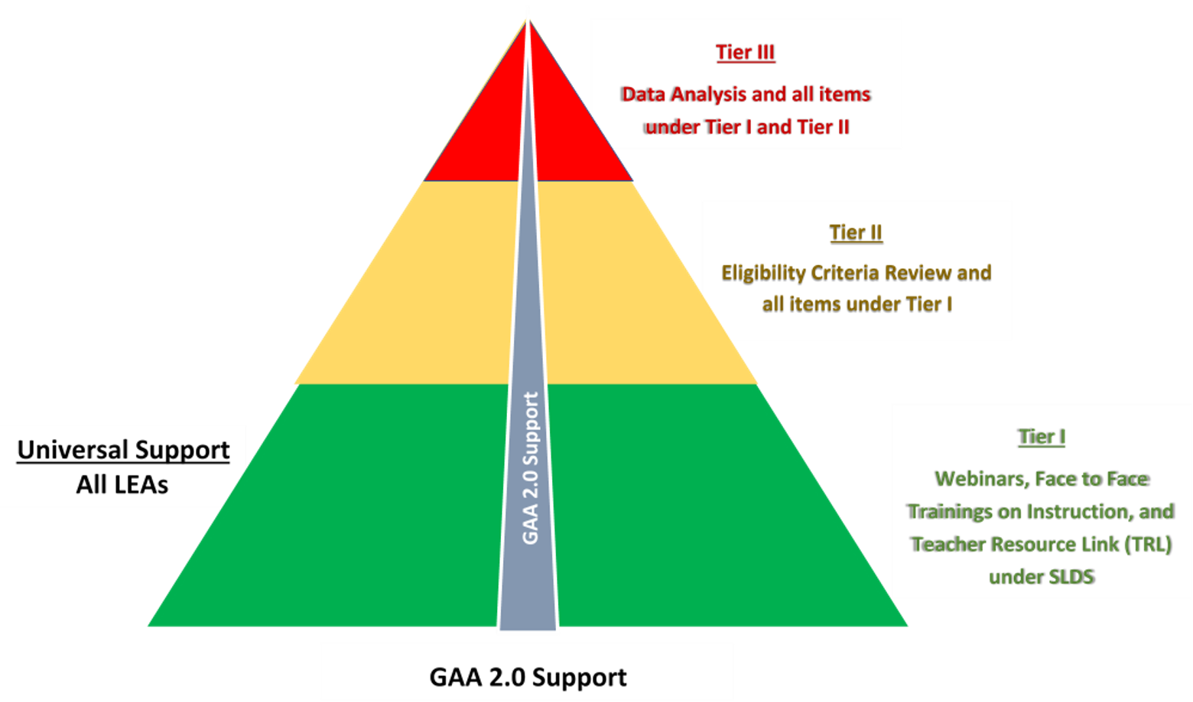
Tiered Support for GAA 2.0 Participation

Slide 17
Leading with Instruction
Abilities
Presentation
Materials
Cautions
Setting
Mode of Communication
Notes:
Reflecting on the appropriate student for the alternate assessment, the Students with the most significant cognitive disabilities.
Mode of Communication
How does the student communicate their wants and needs?
Is our student verbal or non-verbal?
What type of device does the student need a high or low tech device?
Has training on the device been given to the teacher and parent?
How can the teacher evaluate if the device is appropriate for the student?
Abilities
Gaze
Vocalize
Verbalize
Smile (Agree)
Turn their head (Negate)
Turn attention to objects
Functional Vision (Undetermined)
Limited Ability to Understand Concepts
Settings
Time of Testing
Staff on Hand
Positioning
Reduce extraneous text
Reduce clutter
Dark Room
Materials
Tangibles
Light Box
Manipulatives
Motivators
Test Examiner Booklet
Presentation
Color Combinations
Attention to Items
Touching Items
Spacing Items
Repeating directions
Caution
Placement of Items
Reduce Noise
Reduce Traffic
Checking Devices

Slide 18
Student Record Reports

Slide 19
View and Analyze GAA Data
Data Collections created a NEW Student Record Report.
SE066: Special Education Students reports by their PRIMARY AREA of disability
Data are available by:
System Totals
School
Primary Area
Student Level with gender, grade level, age and race/ethnicity

Slide 20
Special Education Reports - SE066
System Totals
Notes:
Looking at the data what are some questions for some the LEAs? For example, LEA 0210 they had 1 student with Moderate Intellectual Disability. I would want to know if the student could benefit from Assistive Technology. The Special Education Department has teamed up with Tools for Life which is located at Georgia Tech to use their technology across the State of GA for our students. Does anyone see anything else?

Slide 21
Using the Report
System Totals
Viewer can quickly view students who are taking the GAA 2.0:
By Grade
By Primary Area
School Level
View totals by school
By Grade
By Primary Area
Student Level
Click on live links (numbers)
Gender, Race/ethnicity, age

Slide 22
Click here to view data by Grade and Primary Area, by School
Notes:
Here is that data

Slide 23
Student Summary Information for SR084
Student Level Report in Student Record By school:
Students with Disabilities (SWD)
Pre-K Program (Special Education and others)
Alternate Math Sequence
Extended School Year (ESY)
GAA 2.0
Other non-SE (ex.: EIP. Migrant, retained…)
Live links to Student Level data for all data elements

Slide 24
Student Report - SR084
Notes:
SR084 students who took the GAA 2.0 are listed in the GAA column.

Slide 25
Using the SR084
Total Students vs. Active Students
Total students number displays a cumulative enrollment for year
Active students number displays the number of students currently enrolled
Use caution when using this number to calculate a percentage of GAA participants
Totals include students in non-testing grades
Notes:
The total number of students from LEA 907 vs. the Active students 14. Non-testing grades 1st and 2nd

Slide 26
Activity I The Eligibility Criteria

Slide 27
Review the Eligibility Criteria and decide if Candace and Mateo are eligible for the GAA 2.0
Notes:
To help you understand the eligibility criteria for a student who may be assessed on the GAA 2.0 we are going to do an activity.
Prior to reviewing the eligibility criteria for GAA, the IEP team must understand all assessment options, including the characteristics of each assessment and the potential implications of each assessment choice.
According to The Official Code of Georgia A. 20 -2-281, School districts are required to follow the procedures specified in the applicable test administration materials. As a result, the IEP team must use this form to document its assessment decisions.
If GAA is being considered, the IEP team must review the 4 criteria below and select YES or NO if applicable to the student. To be eligible to participate in GAA, the answer to all 4 of the questions below must be YES. If the answer to any of the questions is NO, the student is not eligible to participate in GAA and must participate in the GA Milestones Assessment System. Each YES answer requires a justification that contains evidence that the student meets the criteria.

Slide 28
Directions for the Activity
Read the scenario
Review the scenario
Answer the questions
Select a recorder/reporter
Share the responses
Notes:
Okay let us count off by 4’s and go to into the 4 groups. Everything is at your group/station. Are there any questions? You will have about 8 to 10 minutes to complete this activity.

Slide 29
Read and review your case study
Candace
Mateo

Slide 30
Candace

Slide 31
Does the student require intensive individualized instruction in a variety of instructional setting?
Candace
3rd Grade
1. Beginning reader-at kindergarten level; identifies high frequency sight words (kindergarten level); guided reading passage on her instructional level and following multiple exposures to the passage. Counts objects 1-20; recognizes #’s 1-20; adds up to 10 using manipulatives or fingers; below same age peers Demonstrates beginning writing skills; does not independently generate a simple sentence; given grade level prompt and teacher assistance, will write a series of letters and pictures

Slide 32
Does the student have a significant cognitive disability?
Candace
3rd Grade
2. IQ Score: Significant Delays Mental Processing Index –Candace scored 65; below average Sequence processing Standard Score; 66 Adaptive Behavior Overall 66 Socialization 57 Communication 65 Daily Living 79 Below grade level skills
Notes:
Mental Processing Index is a measure of cognitive processing abilities of children and adolescents between the ages 3 and 18. Candace scored 65 which is below average. A Normal Score is 85-115
Sequence Processing Standard Score =66 well below range

Slide 33
Does the student require specialized supports to access and participate in the grade-level GSE that require modifications based on the student’s Present Levels of Academic Achievement and Functional Performance?
Candace
3rd Grade
3. Articulation, /voice/fluency within normal limits; severe lang. deficits in comprehension of basic concepts/wh?/attributes; Expressive language concerns

Slide 34
Does the student require specialized supports to demonstrate age appropriate adaptive behavior?
Candace
3rd Grade
4. Hesitant to join small group conversations given language deficits; in large group follows the lead of others; Unable to read at grade level; she struggles to follow oral teacher directions; requires individual repetition of directions and teacher prompts

Slide 35
Did your group determine that Candace
was eligible for GAA 2.0?
Yes or No?

Slide 36
Candace is not eligible for the GAA 2.0
Reasons
She does not qualify, due to insufficient longitudinal data
Cognitive scores are not at a significant cognitive disability level, nor is adaptive behavior skills overall
No significant deficits noted in parent input
She does display communication needs, but not at a significant level
She is behind grade level peers, but direct instruction and accommodations may improve academic and communication deficits

Slide 37
Mateo

Slide 38
Does the student require intensive individualized instruction in a variety of instructional setting?
Mateo
4th Grade
Reading- No DRA established. Writing – Scores Extremely Low Range in comparison to same age peers, unable to copy words, but can match words with 60%accuracy, uses a scribe but unable to provide sentences independently Math - Extremely Low Range compared to same age peers, matches numbers 1-5 with 100% accuracy and numbers 6 – 10 with 60% accuracy Progress Monitoring Scores - Range from 0% to 10% accuracy with 2 or more verbal/visual prompts

Slide 39
Does the student have a significant cognitive disability?
Mateo
4th Grade
2. Kaufman 49 WISC 41 Low functioning across all settings Adaptive Scale Score 51 Significant delays
Notes:
Mental Processing Index is a measure of cognitive processing abilities of children and adolescents between the ages 3 and 18. Candace scored 65 which is below average. A Normal Score is 85-115
Sequence Processing Standard Score =66 well below range

Slide 40
Does the student require specialized supports to access and participate in the grade-level GSE that require modifications based on the student’s Present Levels of Academic Achievement and Functional Performance?
Mateo
4th Grade
3. Speech/Language OT in school and privately Specifically Designed Instruction across all settings

Slide 41
Does the student require specialized supports to demonstrate age appropriate adaptive behavior?
Mateo
4th Grade
4. Likes Barney, Thomas the Tank Engine, Wiggles, etc. Often will lay on floor, screaming, throwing objects when non-preferred activity is presented or when there are loud noises Restrained at times Often needs sensory input to “cool down” when frustrated iPad is a positive reinforcer motivated with edibles

Slide 42
Did your group determine that Mateo
was eligible for GAA 2.0?
Yes or No?

Slide 43
Mateo is eligible for the GAA 2.0
* The reasons are embedded on Mateo’s eligibility criteria forms

Slide 44
Activity II Questions for IEP teams
Notes:
Districts and schools may benefit from creating a team to review multiple sources of data also this activity is designed to structure, reflect and dialogue among IEP Team members including the director of special education, representatives of school staff who participate as members of an IEP team, curriculum specialists, school principals, school psychologists, related service providers, parents, for English Learners with disabilities, and an English learner specialist. By, having these questions and discussions will assist IEP teams on a goal of being correct when making decisions about the students with the most significant cognitive disabilities being eligible for taking the alternate assessment.

Slide 45
Directions for the Activity
Read the questions
Discuss the questions
Answer the questions
Select a recorder/reporter
Share the responses
* Alternate Assessment aligned to Alternate Academic Achievement Standards (AA-AAAS)
Notes:
Today in 4 different groups are to read the two questions, discuss the questions, answer the questions, select a recorder/reporter and have someone in your group to share answers.

Slide 46
BLUE GROUP
A
What do participation rates on the AA-AAAS look like over time?
B
What do AA-AAAS participation rates look like disaggregated by age, grade level or school level?

Slide 47
GREEN GROUP
A
What do participation rates on the AA-AAAS look like disaggregated by schools?
B
What do AA-AAAS participation rates look like disaggregated by content areas?

Slide 48
RED GROUP
A
What do AA-AAAS participation rates look like disaggregated by student demographics?
B
What do AA-AAAS participation rates look like disaggregated by disability category?

Slide 49
YELLOW GROUP
A
What do AA-AAAS participation rates look like disaggregated by placement?
B
What do AA-AAAS participation rates look like disaggregated by performance level?

Slide 50
Resources
Two Instructional Webinars
https://www.gadoe.org/Curriculum-Instruction-and-Assessment/Special-Education-Services/Pages/Intellectual-Disabilities.aspx
NCEO Tool 4
https://nceo.umn.edu/docs/OnlinePubs/Tool4DialogueGuide.pdf
Georgia Alternate Assessment 2.0 (GAA 2.0)
https://www.gadoe.org/Curriculum-Instruction-and-Assessment/Assessment/Pages/GAA_2.aspx

Slide 51
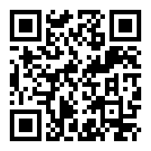
Questions and
Session Evaluation

Slide 52
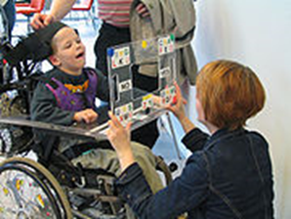
Thank you for attending the session
August Ogletree, Ph.D. – Accountability Research Specialist Assessment & Accountability
aogletree@doe.k12.ga.us
(404) 463-6675
Crystal R. Callaway, M.ED. – Education Program Specialist Special Education Support
ccallaway@doe.k12.ga.us
(404) 764-7321

